Slide 1
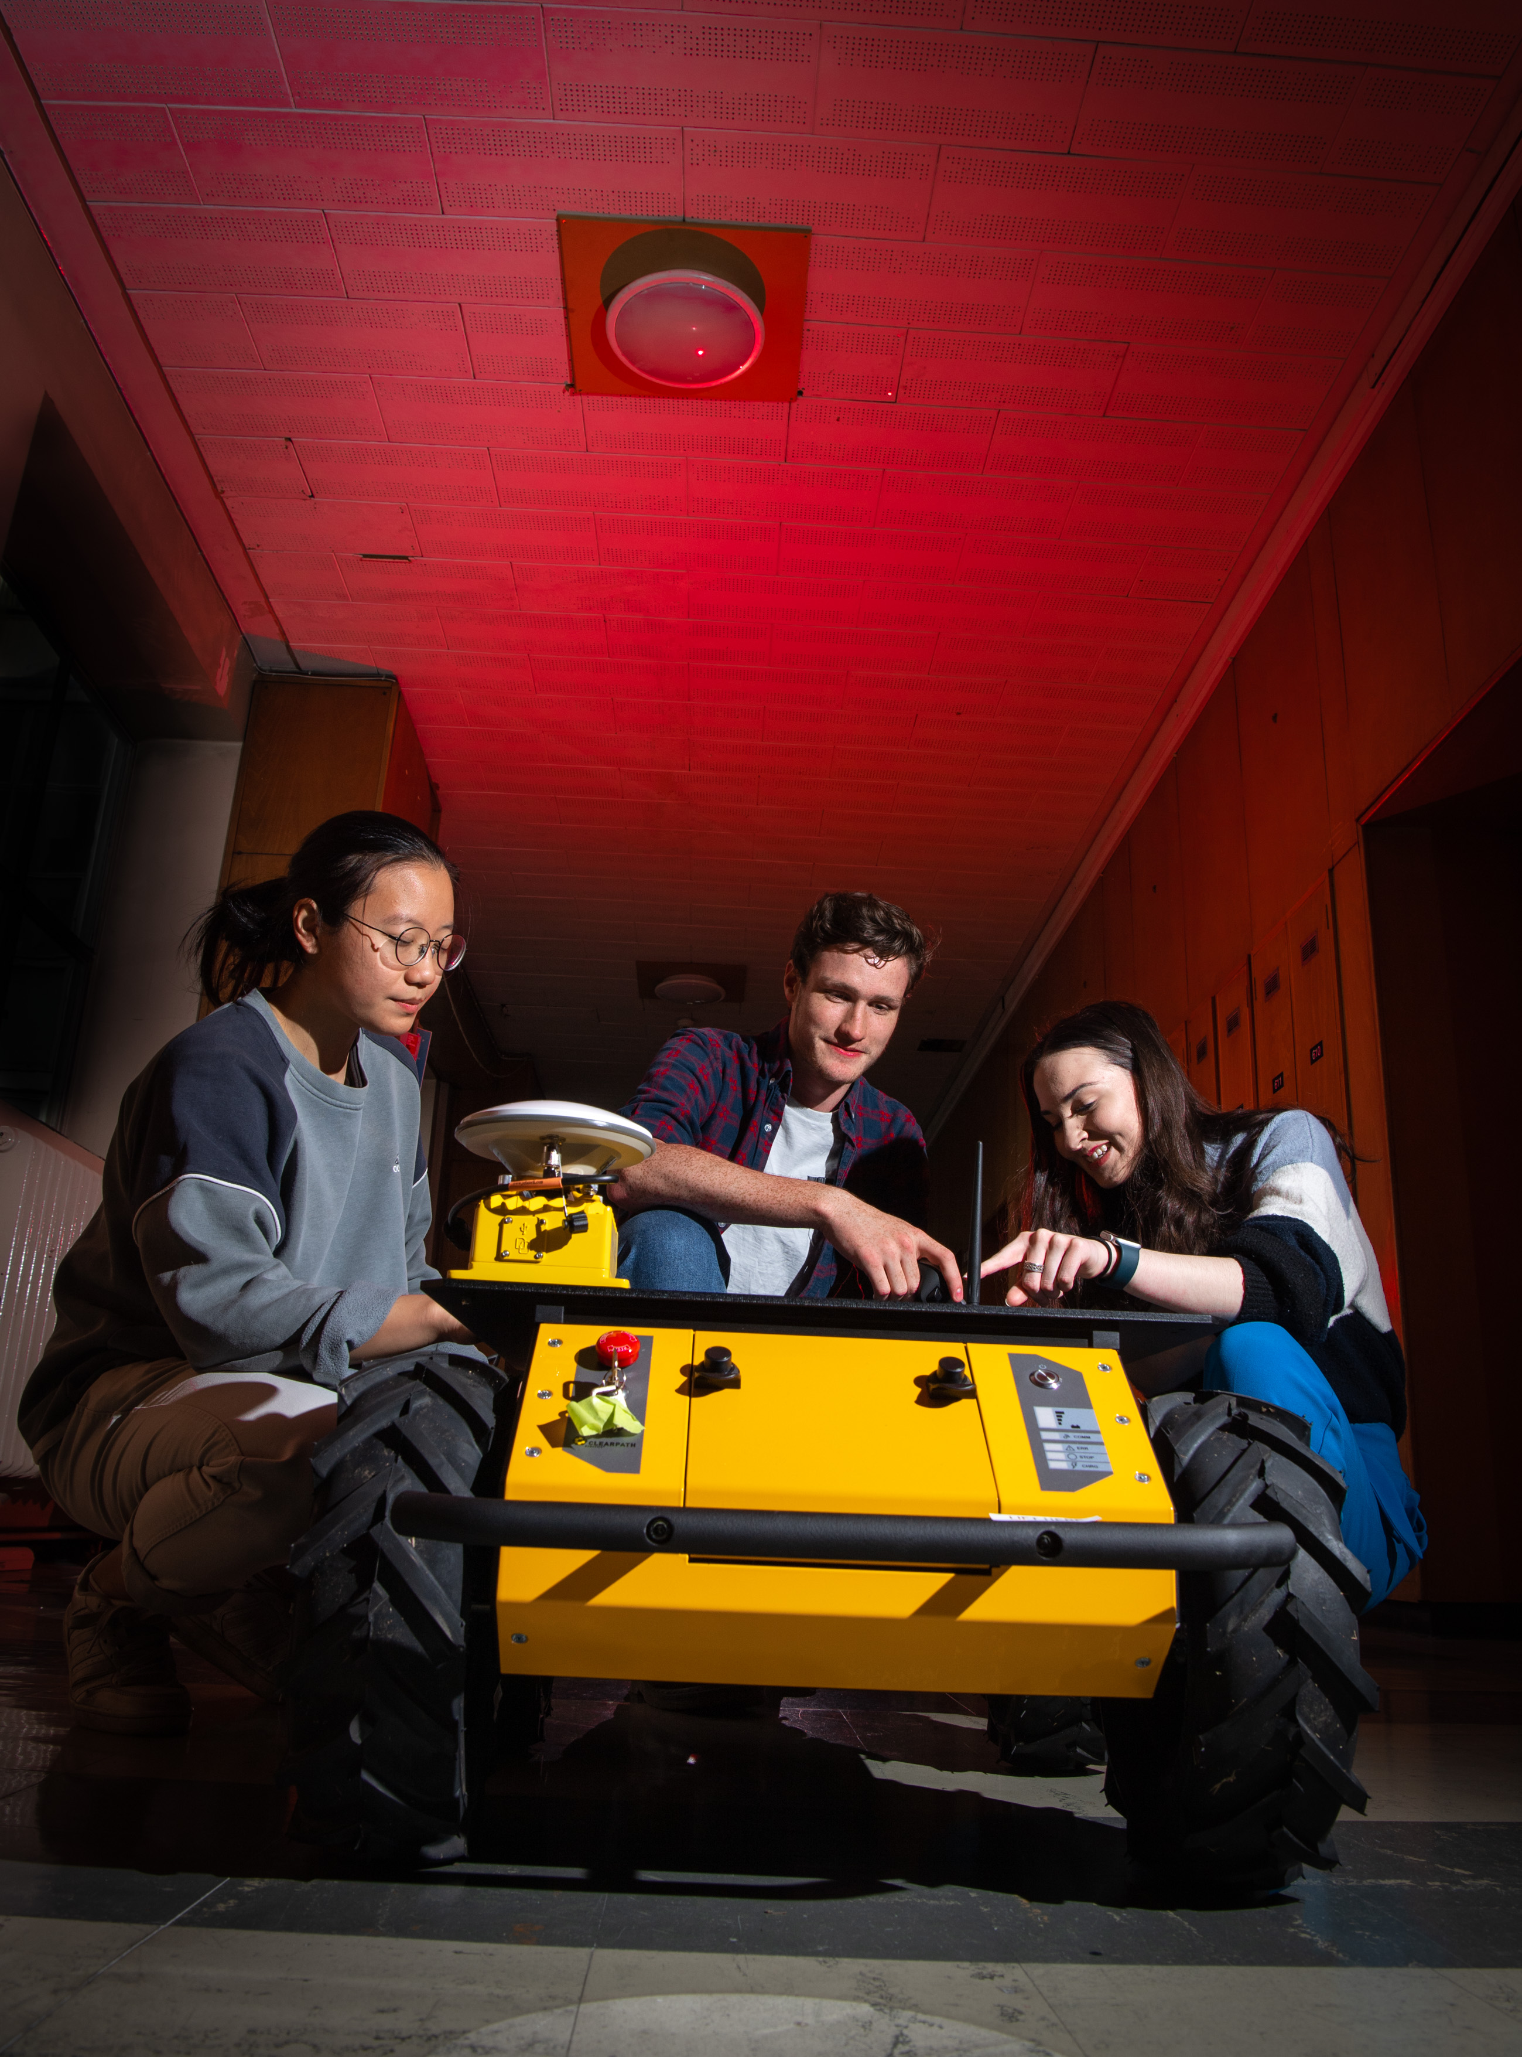


ML for RF: Building Resilient Autonomy in the Electromagnetic Environment
5-Day Intensive Summer School & Challenge
Where RF meets AI in a congested electromagnetic environment —equipping the next generation to secure autonomous systems against intelligent electromagnetic threats.
Immersive training from leading experts in RF systems, machine learning, and contested electromagnetic operations
Applied research and practical exposure to AI-driven Electromagnetic Operations
Dedicated team challenge on Day 5 simulating real-time RF-ML strategies
Unique opportunity to develop and stress-test resilience of AI models in a range of RF system designs and contexts
Access to cutting-edge testbeds, software-defined radios, and EM tools
Network and collaborate with peers from defence, academia, and industry working on next-generation EME resilience
Exceptional professional development for those aiming to lead in AI-for-EM and secure autonomous systems
27 - 31 July 2026 @ University of Glasgow, Scotland
Further information and registration: https://emehub.org/events/
Contact for sponsorship enquiries: emehub@loughborough.ac.uk

Slide 2

ML for RF: Building Resilient Autonomy in the Electromagnetic Environment
5-Day Intensive Summer School & Challenge
Where RF meets AI in a congested electromagnetic environment —equipping the next generation to secure autonomous systems against intelligent electromagnetic threats.
27 - 31 July 2026 @ University of Glasgow, Scotland
Closing date for sponsorship: 30th April 2026
Closing date for participant registration: 1st June 2026
Further information and registration: https://emehub.org/events/
Contact: Dr William Taylor (William.taylor@glasgow.ac.uk)

Slide 3
Course Aims:
This summer school aims to immerse participants in the emerging field of machine learning applied to RF systems, with a focus on developing resilience strategies for autonomous platforms operating in contested electromagnetic environments. Through lectures, hands-on labs, and a final competitive challenge, participants will learn to analyse, simulate, and defend communication links against intelligent jamming and spoofing attempts powered by AI-driven tactics.
Intended Learning Outcomes (ILOs) of the Summer School:
By the end of the summer school, participants will be able to:
Explain the fundamentals of machine learning in RF contexts and its implications for autonomous system resilience.
Design and implement defensive countermeasures using real-time RF sensing, adaptive EPM strategies, and ML-based anomaly detection.
Apply ESM techniques to characterise and anticipate adversarial RF behaviours in live or simulated scenarios.
Develop ML models to protect and increase robustness of UGV command-and-control channels.
Stress-test the resilience of AI models in a range of RF systems designs and contexts
Participants:
This summer school is open to graduate students, early-career researchers, defence professionals, and engineers working in:
RF systems, wireless communications, cybersecurity, or control/autonomy.
AI/ML for communications and signal processing.
Defence, resilient autonomy, or UxV operations.
Participants should have:
A basic understanding of wireless communication principles and RF systems.
Foundational programming skills (Python or similar preferred).
Enthusiasm for hands-on experimentation, red vs blue team strategy, and resilience engineering in electromagnetic conflict scenarios.
For sponsorship enquiries, contact emehub@lboro.ac.uk

